Slide 1


Security – Session 4: Authorization
Prof. Dr.-Ing. Sebastian Schlesinger
Professor of Safe and Secure Cloud and Embedded System Infrastructures

Slide 2
What is the problem domain of Authorization?
Access control to resources
Who is eligible to do something with our resources?
Subjects: Users, Roles, Processes
Objects: Files, Sockets, Programs, Processes
Access types: read, write, change, execute, open, create, trace …
Various ways of ensuring access control
Defined by user (discretionary access control)
Defind by system (mandatory access control)

Slide 3
Access Control I
Security Policies
Discretionary Access Control (DAC)
Policies control access based on the identity of the requestor
and on the access rules stating what requestors are (not) allowed to do
Mandatory Access Control (MAC)
Policies control access based on mandated regulations
determined by a central authority
Role-based Access Control (RBAC)
Policies control access based on the roles that users assume within the system and on access rules stating what accesses are allowed to users with a specific role

Slide 4
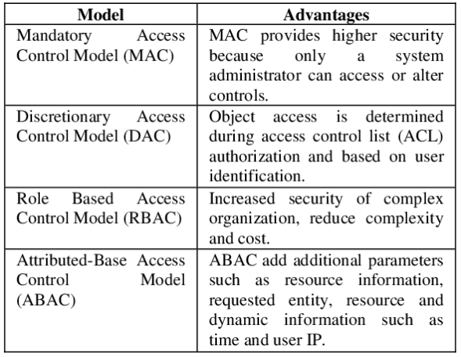
Access Control Models

Slide 5
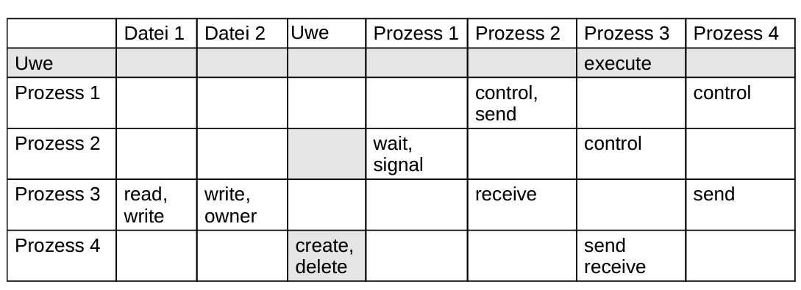
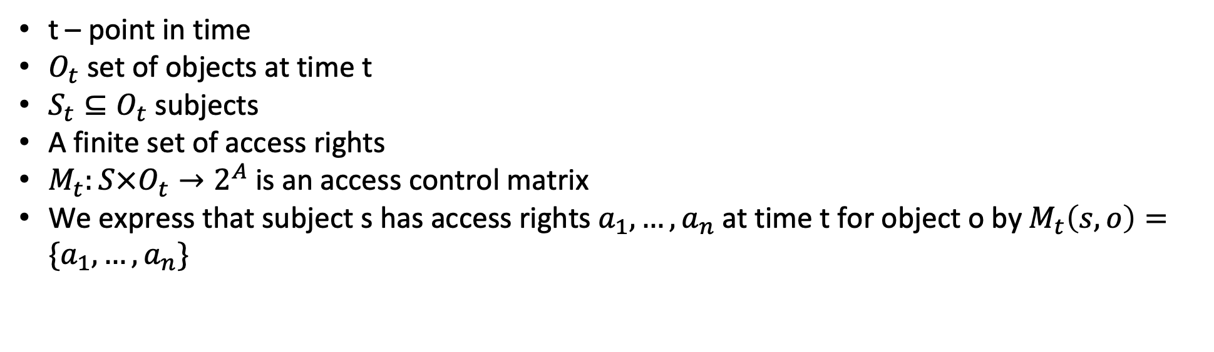
A formal model for DAC – Access Control Matrix
t – point in time
$O_{t}$ set of objects at time t
$S_{t}⊆O_{t}$ subjects
A finite set of access rights
$M_{t}:S×O_{t}→2^{A}$ is an access control matrix
We express that subject s has access rights $a_{1},…,a_{n}$ at time t for object o by $M_{t}\left(s,o\right)=\{a_{1},…,a_{n}\}$

Slide 6
Access Control I
Access Control Lists (ACL)
List of rights for every object
Implemented in UNIX: 9-bit ACL
read write execute read
write
execute
read
write
execute
1 | 1 | 1 | 1 | 0 | 1 | 1 | 0 | 0
privileges of file owner
privileges of user group the object belongs to
privileges of other users

Slide 7
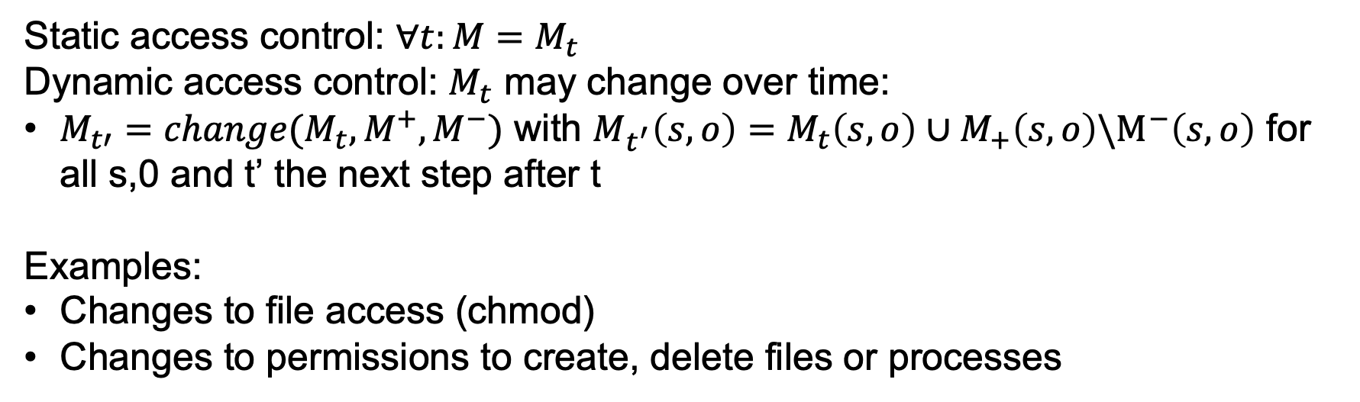
Changes to access control
Static access control: $∀t:M=M_{t}$
Dynamic access control: $M_{t}$ may change over time:
$M_{t′}=change(M_{t},M^{+},M^{−})$ with $M_{t^{′}}\left(s,o\right)=M_{t}\left(s,o\right)∪M_{+}\left(s,o\right)\backslash M^{−}\left(s,o\right)$ for all s,0 and t’ the next step after t
Examples:
Changes to file access (chmod)
Changes to permissions to create, delete files or processes
Principle of Attenuation of Privilege
„A subject s_{i} may not grant a right r to another subject s_{j}
it does not possess itself.“

Slide 8
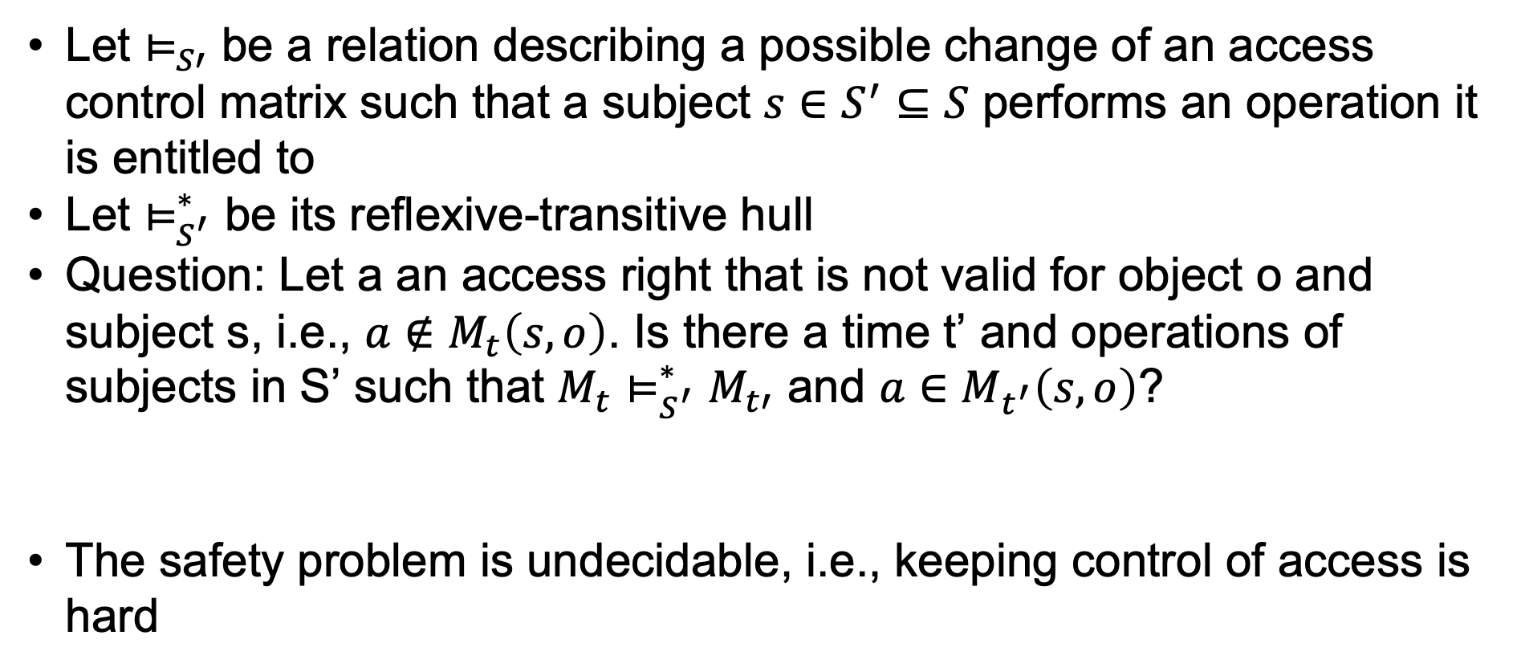
Safety Problem
Let $⊨_{S′}$ be a relation describing a possible change of an access control matrix such that a subject $s∈S^{′}⊆S$ performs an operation it is entitled to
Let $⊨_{S^{′}}^{∗}$ be its reflexive-transitive hull
Question: Let a an access right that is not valid for object o and subject s, i.e., $a∉M_{t}\left(s,o\right)$. Is there a time t’ and operations of subjects in S’ such that ${M_{t}⊨}_{S^{′}}^{∗}M_{t′}$ and $a∈M_{t^{′}}\left(s,o\right)$?
The safety problem is undecidable, i.e., keeping control of access is hard

Slide 9
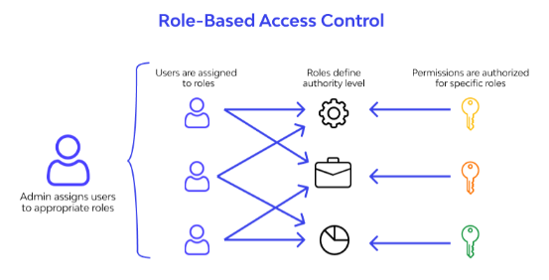
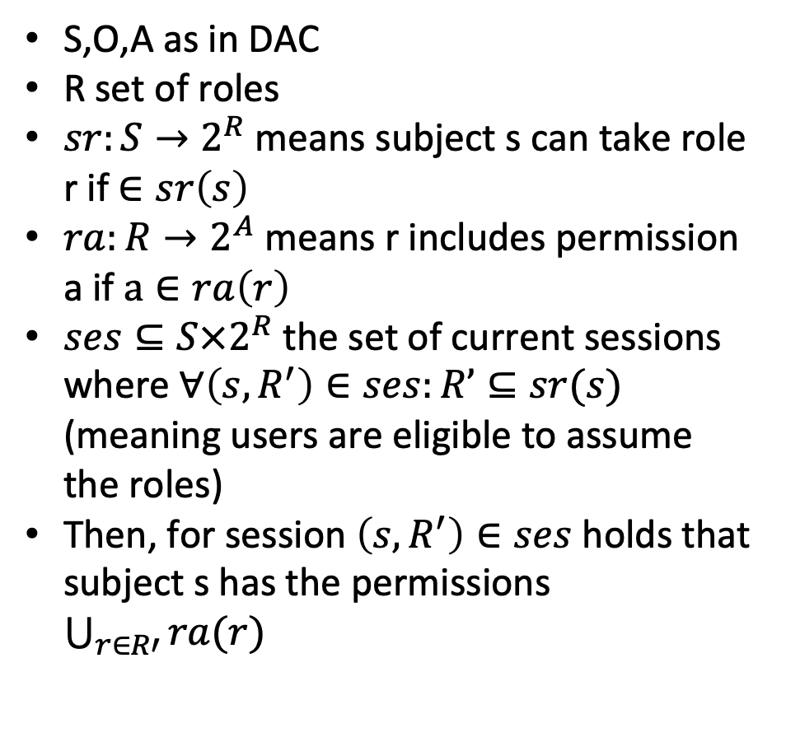
Formal Model for RBAC
S,O,A as in DAC
R set of roles
$sr:S→2^{R}$ means subject s can take role r if $∈sr\left(s\right)$
$ra:R→2^{A}$ means r includes permission a if $a∈ra\left(r\right)$
$ses⊆S×2^{R}$ the set of current sessions where $∀\left(s,R^{′}\right)∈ses:R’⊆sr(s)$ (meaning users are eligible to assume the roles)
Then, for session $\left(s,R^{′}\right)∈ses$ holds that subject s has the permissions $\bigcup_{r∈R′}{ra(r)}$

Slide 10
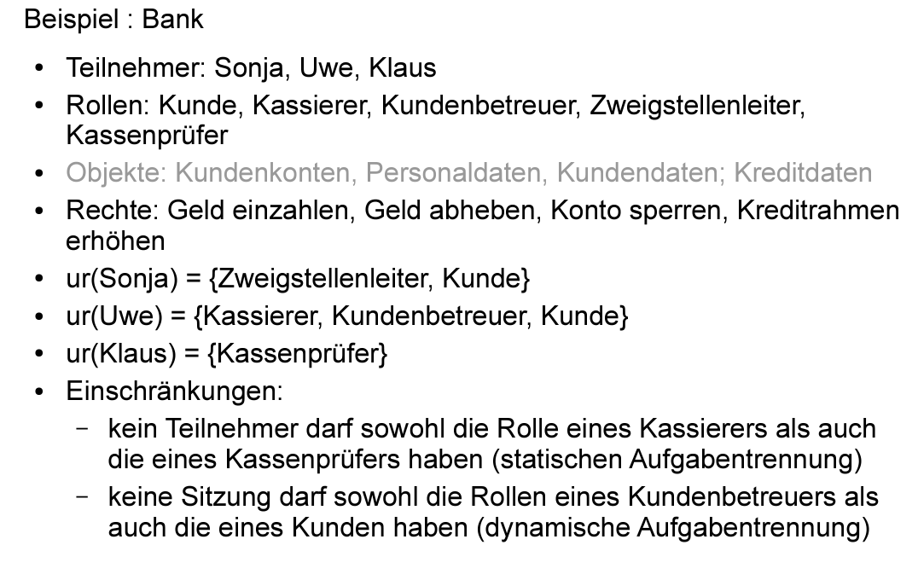
RBAC Example

Slide 11
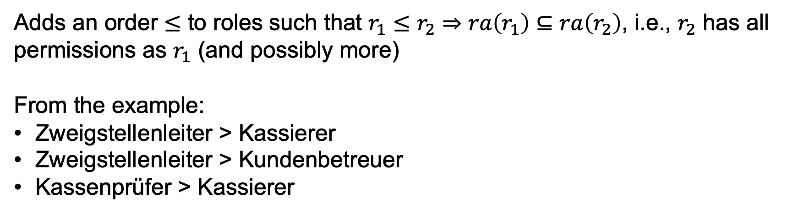
Hierarchical RBAC
Adds an order $≤$ to roles such that $r_{1}≤r_{2}⇒ra\left(r_{1}\right)⊆ra\left(r_{2}\right)$, i.e., $r_{2}$ has all permissions as $r_{1}$ (and possibly more)
From the example:
Zweigstellenleiter > Kassierer
Zweigstellenleiter > Kundenbetreuer
Kassenprüfer > Kassierer

Slide 12
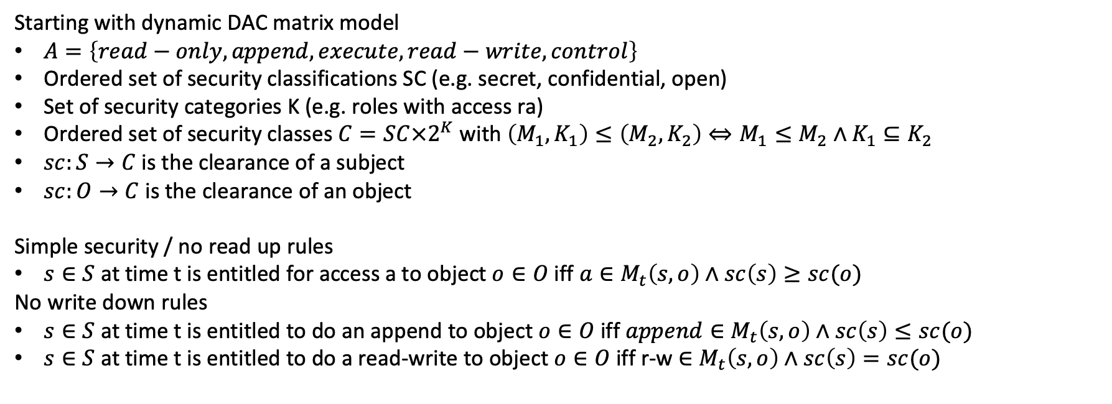
Bell La Padula
Starting with dynamic DAC matrix model
$A=\left\{read−only, append, execute, read−write, control\right\}$
Ordered set of security classifications SC (e.g. secret, confidential, open)
Set of security categories K (e.g. roles with access ra)
Ordered set of security classes $C=SC×2^{K}$ with $\left(M_{1},K_{1}\right)≤\left(M_{2},K_{2}\right)⇔M_{1}≤M_{2}∧K_{1}⊆K_{2}$
$sc:S→C$ is the clearance of a subject
$sc:O→C$ is the clearance of an object
Simple security / no read up rules
$s∈S$ at time t is entitled for access a to object $o∈O$ iff $a∈M_{t}\left(s,o\right)∧sc\left(s\right)≥sc(o)$
No write down rules
$s∈S$ at time t is entitled to do an append to object $o∈O$ iff $append∈M_{t}\left(s,o\right)∧sc\left(s\right)≤sc(o)$
$s∈S$ at time t is entitled to do a read-write to object $o∈O$ iff r-w $∈M_{t}\left(s,o\right)∧sc\left(s\right)=sc(o)$

Slide 13
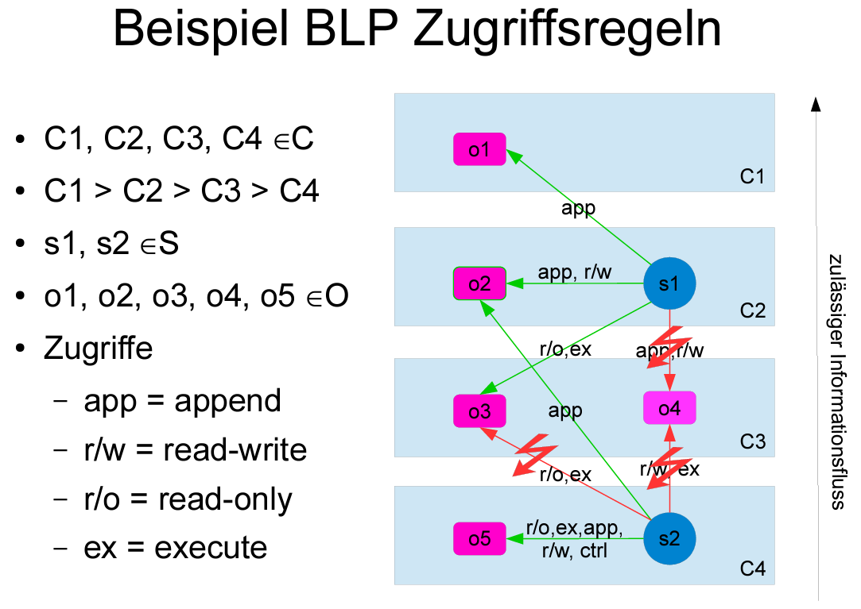

Slide 14
Realisations of Access Control – Linux
Demo Linux
Chmod, access rights

Slide 15
Windows – Active Directory
Domain Services
What is Active Directory?
A collection of services (Server Roles and Features) used to manage identity and access for and to resources on a network
Internal Accounts
Authorization
Authentication
Federation Services
Certificate Services
Network Access for External Resources
Identity
Non-Repudiation
AD Domain Services (AD DS)
Users, Computers, Policies
AD Certificate Services (AD CS)
Service, Client, Server and User identification
AD Federation Services (AD FS)
Resource access across traditional boundaries
AD Rights Management Services (AD RMS)
Maintain security of data
AD Lightweight Directory Services (AD LDS)
Active Directory
Identity
Access
Centralized Management
Rights Management Services
Lightweight Directory Services
Content Security and Control
Application Templates

Slide 16
AD Roles
Windows Server
Mgmt Profile
Network Info
Printers
Shares
What is Active Directory Domain Services?
A directory service is both the directory information source and the service that makes the information available and usable
A phone book…
Task: Scalable, secure, and manageable infrastructure for user and resource management
stores and manages information about network resources
provides support for directory-enabled applications such as Microsoft® Exchange Server
allows for centralized management
Windows User
Windows Client
Account Information
Privileges
Profiles
Policies
Mgmt Profile
Network Info
Policies
Active Directory Domain Services
Manageability
Security
Interoperability
Email Servers
Network Devices
Mailbox Information
Address Book
Applications
Config
QoS Policy
Security Policy
Server Config
SSO
App-Specific Directory Info

Slide 17
AD Roles
Certificate Signing Request
2
AD CS is the Microsoft implementation of Public Key Infrastructure (PKI)
PKI is a set of hardware, software, people, policies, and procedures needed to create, manage, distribute, use, store, and revoke digital certificates
Enrollment
Certificate Repository
3
x.509 Certificate Chain
End-Entities (users or computers)
Certification Revocation Repository
Certificate Retrieval
4
1
CRL Retrieval
Certificate Revocation List
5
Revocation Request

Slide 18












AD Roles
Active Directory Rights Management Services (AD RMS)
Allows individuals and administrators to specify access permissions to documents, workbooks, and presentations
prevent sensitive information from being printed, forwarded, or copied by unauthorized people
access and usage restrictions are enforced no matter where the information is located
RMS Server
Information Author
Recipient

Slide 19







AWS Identity and Access Management (IAM)
Securely control individual and group access to your AWS resources
Integrates with other AWS services
Federated identity management
Granular permissions
Support for multi-factor authentication
AWS Identity and Access Management (IAM)
Notes:
AWS Identity and Access Management is also known as IAM. It is a service that allows you configure fine-grained access control to AWS resources. IAM enables security best practices by allowing you to grant unique security credentials to users and groups. These credentials specify which AWS service application programming interfaces (APIs) and resources they can access. IAM is secure by default. Users have no access to AWS resources until permissions are explicitly granted.
IAM is integrated into most AWS services. You can define access controls from one place in the AWS Management Console, and they will take effect throughout your AWS environment.
You can use IAM to grant your employees and applications access to the AWS Management Console and to AWS service APIs by using your existing identity systems. AWS supports federation from corporate systems like Microsoft Active Directory and standards-based identity providers. IAM also supports multi-factor authentication (MFA). If MFA is enabled and an IAM user attempts to log in, they will be prompted for an authentication code. The authentication code is delivered to an AWS MFA device. The MFA device can be a hardware MFA device. It can also be a virtual MFA device that the user accesses through an application that runs on the user's smartphone, such as Google Authenticator.
You can create accounts that have privileges similar to the AWS account root user. However, is better to create administrative accounts that grant only the account permissions that are needed. Follow the principle of least privilege. For example, ask yourself if your database administrator (DBA) should be able to provision EC2 instances. If the answer is no, then provision accounts accordingly.

Slide 20








IAM components: Review
Defined in your AWS account. Use credentials to authenticate programmatically or via the AWS Management Console.
IAM user
A collection of IAM users that are granted identical authorization.
Amazon Elastic Compute Cloud (Amazon EC2) instances
Full access
IAM group
Read-only
Amazon Simple Storage Service (Amazon S3) bucket
Defines which resources can be accessed and the level of access to each resource.
IAM user, IAM group, or IAM role
IAM policy
IAM policies
Mechanism to grant temporary access for making AWS service requests. Assumable by a person, application, or service.
IAM role
Notes:
To understand how to use IAM to secure your AWS account, it is important to understand the role and function of each of the four IAM components.
An IAM user is a person or application that is defined in an AWS account, and that must make API calls to AWS products. Each user must have a unique name (with no spaces in the name) within the AWS account, and a set of security credentials that is not shared with other users. These credentials are different from the AWS account root user security credentials. Each user is defined in one and only one AWS account.
An IAM group is a collection of IAM users. You can use IAM groups to simplify how you specify and manage permissions for multiple users.
An IAM policy is a document that defines permissions to determine what users can and cannot do in the AWS account.
An IAM role is a tool for granting temporary access to specific AWS resources in an AWS account.

Slide 21
IAM permissions
How IAM determines permissions at the time of request:
IAM policy
Is the permission explicitly denied ?
Is the permission explicitly allowed ?
Permissions are specified in an IAM policy:
A document formatted in JavaScript Object Notation (JSON)
It defines which resources and operations are allowed
Best practice – follow the principle of least privilege
Two types of policies –
Identity-based: Attach to an IAM principal
Resource-based: Attach to an AWS resource
No
No
Deny
Implicit deny
Yes
Yes
Deny
Allow
Notes:
In IAM, permissions are defined in IAM policy documents. Policies enable you to fine-tune privileges that are granted to principals. Example principals are IAM users, IAM roles, or other AWS services.
When IAM determines whether a permission is allowed, IAM first checks for the existence of any applicable explicit denial policy. If no explicit denial exists, it then checks for any applicable explicit allow policy. If an explicit deny or an explicit allow policy does not exist, IAM reverts to the default and denies access. This process is referred to as an implicit deny. The user will be permitted to take the action only if the requested action is not explicitly denied and is explicitly allowed.
When you develop IAM policies, it can be difficult to determine whether access to a resource will be granted to an IAM entity. The IAM Policy Simulator is a useful tool for testing and troubleshooting IAM policies.
Policies are stored as JavaScript Object Notation (JSON) documents. They are attached to principals as identity-based policies, or to resources as resource-based policies.

Slide 22


Identity-based versus resource-based policies
Identity-based policies
Attached to a user, group, or role
Types of policies
AWS managed
Customer managed
Inline
Resource-based policies
Attached to AWS resources
Example: Attach to an Amazon S3 bucket
Always an inline policy
Notes:
Identity-based policies are permission policies that you can attach to a principal (or identity), such as an IAM user, role, or group. These policies control what actions that identity can perform, on which resources, and under what conditions.
Identity-based policies can be further categorized as AWS managed, customer managed, or inline. AWS managed policies are created and managed by AWS, and you can attach them to multiple users, groups, and roles in your AWS account. If you are new to using policies, we recommend that you start by using AWS managed policies. Customer managed policies are policies that you create and manage in your AWS account. Customer managed policies provide more precise control over your policies than AWS managed policies. You can create and edit an IAM policy in the visual editor or by creating the JSON policy document directly. Inline policies are policies that you create and manage, and that are embedded directly into a single user, group, or role.
Resource-based policies are JSON policy documents that you attach to a resource, such as an Amazon Simple Storage Service (Amazon S3) bucket. These policies control which actions a specified principal can perform on that resource and under what conditions. Resource-based policies are inline policies, and there are no managed resource-based policies.

Slide 23
IAM policy document structure
{
"Version": "2012-10-17",
"Statement":[{
"Effect": "effect",
"Action": "action",
"Resource": "arn",
"Condition":{
"condition":{
"key": "value"
}
}
}]
}
Effect: Effect can be either Allow or Deny
Action: Type of access that is allowed or denied
"Action": "s3:GetObject"
Resource: Resources that the action will act on
"Resource": "arn:aws:sqs:us-west-2:123456789012:queue1"
Condition: Conditions that must be met for the rule to apply
"Condition" : {
"StringEquals" : {
"aws:username" : "johndoe"
}
}
Notes:
IAM policies are stored in AWS as JSON documents. Identity-based policies are policy documents that you attach to a user or role. Resource-based policies are policy documents that you attach to a resource. A policy document includes one or more individual statements. Each statement includes information about a single permission. If a policy includes multiple statements, AWS applies a logical OR across the statements when it evaluates them.
The following are common elements found in an IAM policy document:
Version – Specify the version of the policy language that you want to use. As a best practice, use the latest 2012-10-17 version.
Statement – Use this main policy element as a container for the following elements. You can include more than one statement in a policy.
Effect – Use Allow or Deny to indicate whether the policy allows or denies access.
Principal – If you create a resource-based policy, you must indicate the account, user, role, or federated user that you would like to allow or deny access to. If you are creating an IAM permissions policy to attach to a user or role, you cannot include this element. The principal is implied as that user or role.
Action – Include a list of actions that the policy allows or denies.
Resource – If you create an IAM permissions policy, you must specify a list of resources to which the actions apply. If you create a resource-based policy, this element is optional.
Condition (Optional) – Specify the circumstances where the policy grants permissions.

Slide 24

ARNs and wildcards
Resources are identified by using Amazon Resource Name (ARN) format
Syntax – arn:partition:service:region:account:resource
Example – "Resource": "arn:aws:iam::123456789012:user/mmajor"
You can use a wildcard (*) to give access to all actions for a specific AWS service
Examples –
"Action": "s3:*"
"Action": "iam:*AccessKey*"
Notes:
For identity-based (IAM permissions) policies, you must specify a list of resources that the actions apply to. The Resource element specifies the object or objects that the statement covers. Statements must include either a Resource or a NotResource element.
Most resources have a friendly name (for example, a user named Bob or a group named Developers). However, the permissions policy language requires you to specify the resource or resources using the following Amazon Resource Name (ARN) format.
Each service has its own set of resources. Although you always use an ARN to specify a resource, the details of the ARN for a resource depend on the service and the resource. For information about how to specify a resource, refer to the documentation for the service whose resources you are writing a statement for.
You can also use wildcards in IAM policy documents, such as in ARNs or in Actions. You can use the wildcard character (*). An asterisk (*) represents any combination of zero or more characters. For example, an “Action” value of "s3:*" applies to all S3 actions. You can also use wildcards (*) as part of the action name. For example, the ”Action” value of "iam:*AccessKey*" applies to all IAM actions that include the string AccessKey, including CreateAccessKey, DeleteAccessKey, ListAccessKeys, and UpdateAccessKey.

Slide 25

IAM policy example
{
"Version": "2012-10-17",
"Statement":[{
"Effect":"Allow",
"Action":["DynamoDB:*","s3:*"],
"Resource":[ "arn:aws:dynamodb:region:account-number-without-hyphens:table/table-name",
"arn:aws:s3:::bucket-name",
"arn:aws:s3:::bucket-name/*"]
},
{
"Effect":"Deny",
"Action":["dynamodb:*","s3:*"],
"NotResource":["arn:aws:dynamodb:region:account-number-without-hyphens:table/table-name”,
"arn:aws:s3:::bucket-name",
"arn:aws:s3:::bucket-name/*"]
}
]
}
Explicit allow gives users access to a specific DynamoDB table and…
…Amazon S3 buckets.
Explicit deny ensures that the users cannot use any other AWS actions or resources other than that table and those buckets.
An explicit deny statement takes precedence over an allow statement.
Notes:
As mentioned previously, IAM policy documents are written in JSON.
This example IAM policy grants user access only to the following resources:
The Amazon DynamoDB table whose name is represented by table-name.
The AWS account's S3 bucket, whose name is represented by bucket-name and all the objects that it contains.
The IAM policy also includes an explicit deny ("Effect":"Deny") element. The NotResource element helps to ensure that users cannot use any other DynamoDB or S3 actions or resources, except the actions and resources that are specified in the policy. This is the case even if permissions have been granted in another policy. An explicit deny statement takes precedence over an allow statement.

Slide 26
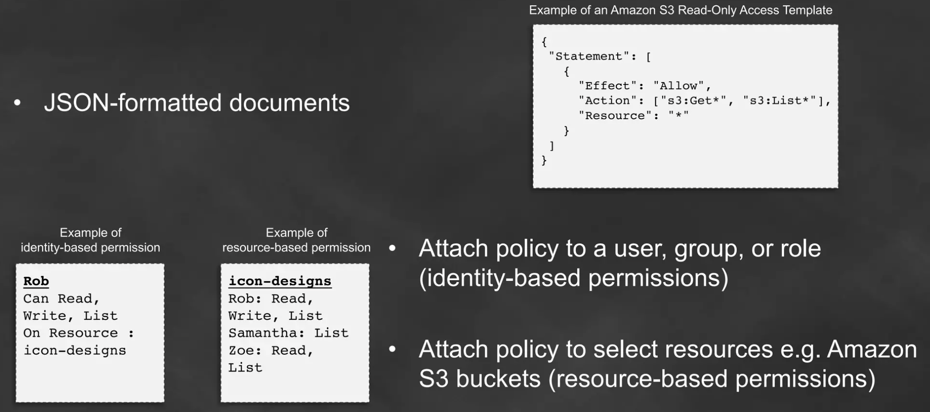
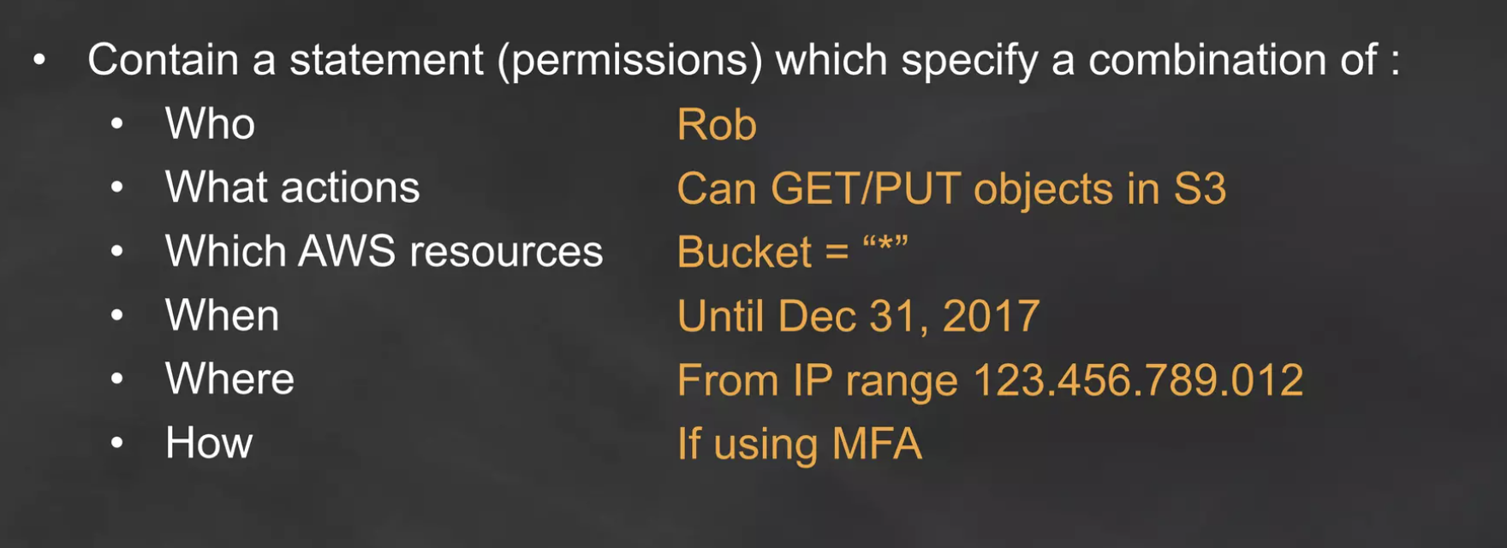
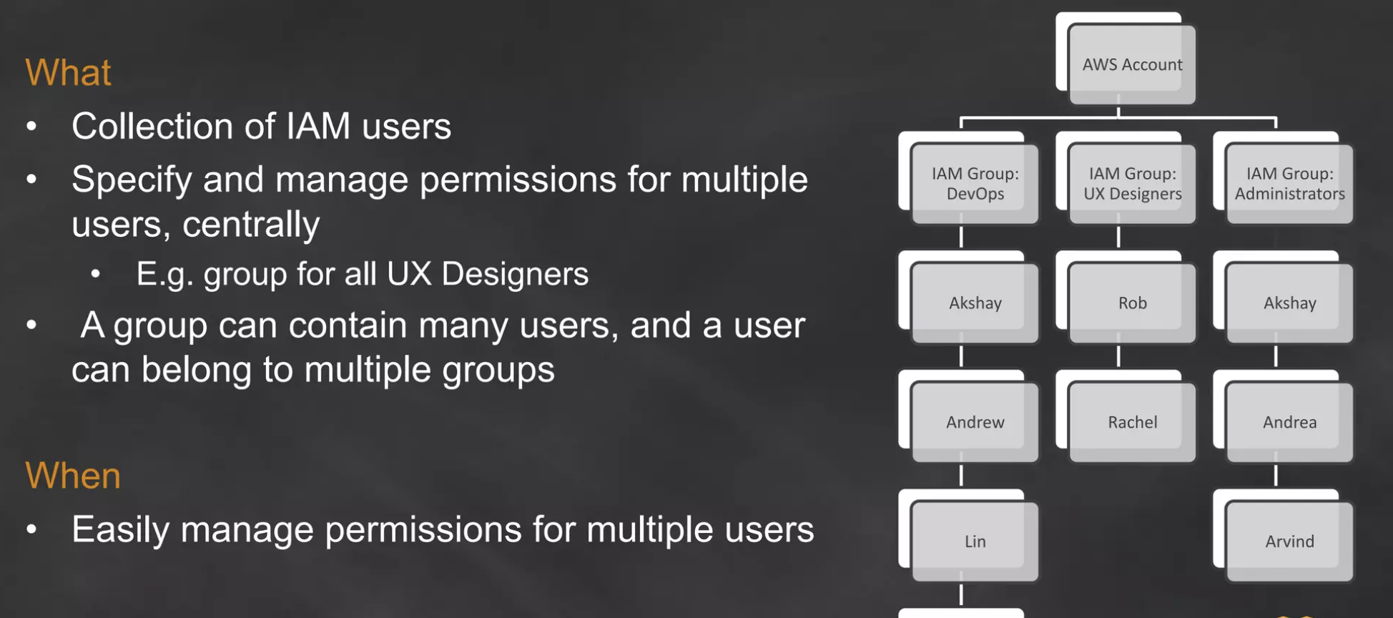
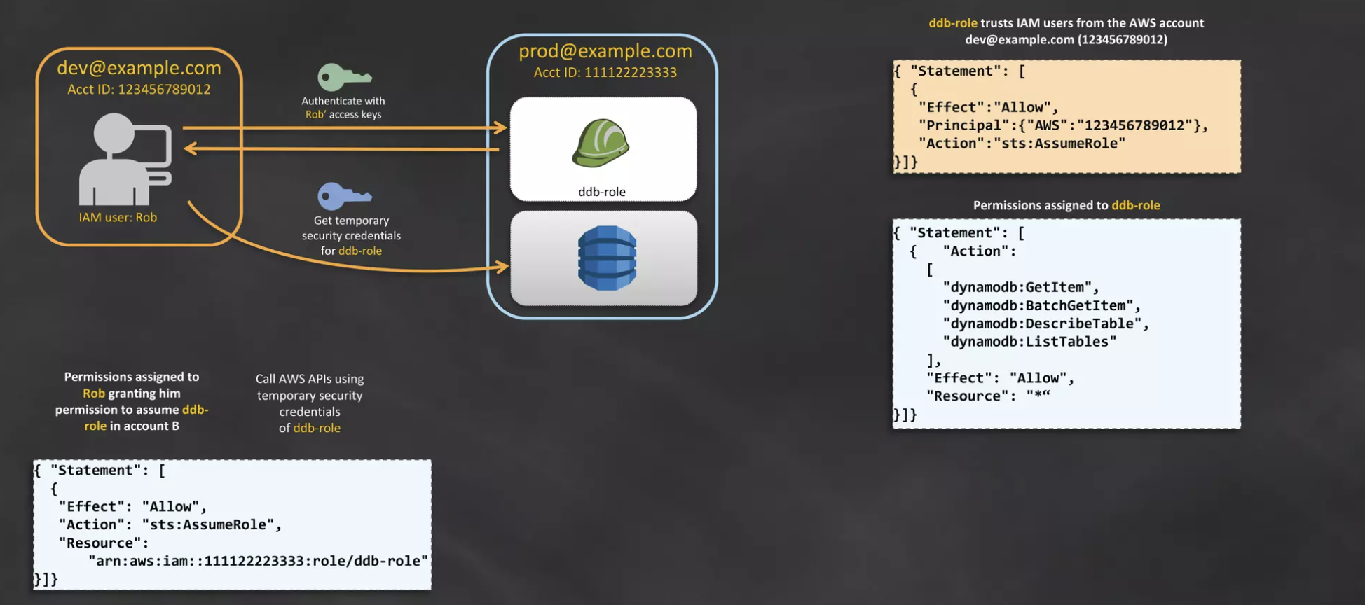
Access Control at AWS - IAM Policies, Groups, and Roles

Slide 27
Activity: IAM Policy analysis (3 of 3)
Consider this IAM policy, then answer the questions.
{
"Version": "2012-10-17",
"Statement":[{ "Condition": { "StringNotEquals": { "ec2:InstanceType": [ "t2.micro", "t2.small" ] } }, "Resource": "arn:aws:ec2:*:*:instance/*", "Action": [ "ec2:RunInstances", "ec2:StartInstances" ], "Effect": "Deny" }
]
What actions does the policy allow?
Say that the policy included an additional statement object, like this example:
{
"Effect": "Allow",
"Action": "ec2:*",
"Resource": "*"
}
How would the policy restrict the access granted to you by this additional statement?
If the policy included both the statement on the left and the statement in question 2, could you terminate an m3.xlarge instance that existed in the account?
Notes:
Observe the third and last IAM policy document example. The educator will again ask you a series of questions to assess whether you understand what actions this policy will allow and deny.

Slide 28
Activity: IAM Policy analysis (3 of 3)
Consider this IAM policy, then answer the questions.
{
"Version": "2012-10-17",
"Statement":[{ "Condition": { "StringNotEquals": { "ec2:InstanceType": [ "t2.micro", "t2.small" ] } }, "Resource": "arn:aws:ec2:*:*:instance/*", "Action": [ "ec2:RunInstances", "ec2:StartInstances" ], "Effect": "Deny" }
]
What actions does the policy allow?
ANSWER: It does not allow you to do anything (the effect is to Deny).
Say that the policy included an additional statement object, like this example:
{
"Effect": "Allow",
"Action": "ec2:*”, "Resource": "*"
}
How would the policy restrict the access granted to you by this additional statement?
ANSWER: You would have full Amazon EC2 service access. However you would only be allowed to launch or start EC2 instances of instance type t2.micro or t2.small.
If the policy included both the statement on the left and the statement in question 2, could you terminate an m3.xlarge instance that existed in the account?
ANSWER: Yes.
Notes:
The answers are revealed.

Slide 29


IAM groups
Use IAM groups to grant the same access rights to multiple users.
All users in the group inherit the permissions assigned to the group
Makes it easier to manage access across multiple users
Tip: Combine approaches for fine-grained individual access
Add the user to a group to apply standard access based on job function
Optionally attach an additional policy to the user for needed exceptions
One-off approach to managing access.
IAM policy A
Attached
to
IAM User
Access
resource
IAM policy B
More manageable approach.
IAM User
member
of
IAM policy A
Attached
to
IAM Group
Access
resource
IAM policy B
Notes:
An IAM group is a collection of IAM users. Groups are a convenience that makes it easier to manage permissions for a collection of users, instead of managing permissions for each individual user.
Manage group membership as a simple list:
Add users to a group or remove them from a group.
A user can belong to multiple groups.
Groups cannot belong to other groups.
Groups can be granted permissions by using access control policies.
Groups do not have security credentials and cannot access web services directly. They exist solely to make it easier to manage user permissions.

Slide 30
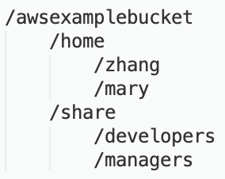
Use case for IAM with Amazon S3
IAM policy grants read, write, list access to /awsexamplebucket/home/zhang
Bucket with home directories for each employee and a share area for groups.
Attached
to
Developer
IAM user
zhang
Member
of
IAM group
IAM policy grants read, write, list access to /awsexamplebucket/share/developers
Notes:
This example demonstrates how IAM permissions might be configured on an S3 bucket.
The awsexamplebucket has two main directories. The home directory has subdirectories for each user, where they can store individual work. The share directory has subdirectories where different teams can store content.
If a new team member, zhang, joins the organization as a developer, you can take three actions to grant them the proper access.
First, add zhang to the IAM group for developers. Notice that this group has an IAM policy attached to it that grants access to /awsexamplebucket/share/developers.
Next, create the /awsexamplebucket/home/zhang directory in Amazon S3.
Finally, attach an IAM policy that grants access to the /awsexamplebucket/home/zhang directory directly to the zhang IAM user. Zhang's access will include both the rights that were granted from the group and also the rights that were directly attached to the IAM user principal.

Slide 31



IAM roles
AWS account 2
IAM role characteristics
Provides temporary security credentials
Is not uniquely associated with one person
Is assumable by a person, application, or service
Is often used to delegate access
Use cases
Provide AWS resources with access to AWS services
Provide access to externally authenticated users
Provide access to third parties
Switch roles to access resources in –
Your AWS account
Any other AWS account (cross-account access)
IAM
user
AWS account 1
3
Role used to access
S3
bucket
IAM User
Role assumed
by
2
EC2 instance (with application)
Attached
to
IAM role
IAM policy
1
Notes:
An IAM role enables you to define a set of permissions to access the resources that a user or service needs. However, the permissions are not attached to an IAM user or group. Instead, the permissions are attached to a role, and the role is assumed by the user or the service.
When a user assumes a role, the user's prior permissions are temporarily forgotten. AWS returns temporary security credentials that the user or application can then use to make programmatic requests to AWS.
By using IAM roles, you don’t need to share long-term security credentials for each entity that requires access to a resource, such as creating an IAM user.
For a service like Amazon EC2, applications or AWS services can programmatically assume a role at runtime.
The principal that assumes the role could also be an IAM user, group, or role from another AWS account, including accounts that are not owned by you.
By creating a role for external account access, you don’t need to manage user names and passwords for third parties. If you no longer want someone or some system to have access, you can modify or delete the role. Thus, you don’t need to create and manage accounts for people outside of your organization.

Slide 32



Summary: EC2 instance profile demonstration
Scenario:
An application that runs on an EC2 instance needs access to an S3 bucket
Solution:
Define an IAM policy that grants access to the S3 bucket
Attach the policy to a role
Allow the EC2 instance to assume the role
AWS Cloud
Application has permissions to access the S3 bucket
Amazon EC2 instance
Application
3
S3 bucket
Role assumed by the EC2 instance
2
attached
IAM role
1
IAM policy grants access to bucket
Notes:
This diagram illustrates the educator-led demonstration.
An application runs on an EC2 instance, and that application needs access to the S3 bucket.
An administrator creates an IAM role.
Then, they create an IAM policy that grants read-only access to the specified S3 bucket. The policy also includes a trust policy that allows the EC2 instance to assume the role and retrieve the temporary credentials.
Next, they attach the IAM policy to the role.
When the application runs on the instance, it can assume the role and use the role's temporary credentials to access the bucket.
With this architecture, the administrator does not need to directly grant the application developer permission to access the bucket, and the developer never needs to share or manage credentials.

Slide 33

Grant permissions to assume a role
For an IAM user, application, or service to assume a role, you must grant permissions to switch to the role
AWS Security Token Service (AWS STS)
Web service that enables you to request temporary, limited-privilege credentials
Credentials can be used by IAM users or for users that you authenticate (federated users)
Example policy – Allows an IAM user to assume a role
AWS Security Token Service (AWS STS)
{
"Version": "2012-10-17",
"Statement": {
"Effect": "Allow",
"Action": "sts:AssumeRole",
"Resource": "arn:aws:iam::123456789012:role/Test*"
}
}
Notes:
AWS Security Token Service is also known as AWS STS. It is a web service that enables an IAM user, federated user, or application to assume an IAM role that they want.
When the AssumeRole operation of the AWS STS API is successfully invoked, the web service returns the temporary, limited-privilege credentials that were requested by the IAM user or the user that was authenticated through federation. Typically, the AssumeRole operation is used for cross-account access or for federation.
The example policy allows an IAM user to assume any role that is defined in AWS account number 123456789012, as long as the role name starts with Test.

Slide 34




Role-based access control (RBAC)
Traditional approach to access control:
Grant users specific permissions based on job function (such as database administrator)
Create a distinct IAM role for each permission combination
Update permissions by adding access for each new resource (it can become time-consuming to keep updating policies)
Users
Permissions
Resources
Notes:
You will now consider two different approaches to access control: role-based access control (RBAC) and attribute-based access control (ABAC). You will first learn about RBAC.
RBAC has been used historically on-premises and in the cloud. With this model, you grant users explicit access to a set of permissions. Say that you have database administrators, network administrators, and developers. If you have one or more network administrators who are also developers, you would not create a new policy to grant those permissions. Instead, you add those users to both roles.
This approach is familiar and has many advantages. However, the person who maintains the permissions in this model might find that they must constantly update the permissions files to add access to certain roles each time a new resource is created. For example, they must update a policy with an ARN each time someone creates a new resource and wants to allow users access to it.

Slide 35
Best practice: Tagging
A tag consists of a name and (optionally) a value
Can be applied to resources across your AWS accounts
Tag keys and values are returned by many different API operations
Define custom tags
Multiple practical uses
Billing, filtered views, access control, etc.
Example tags applied to an EC2 instance:
Name = web server
Project = unicorn
Stack = dev
Tags can also be applied to IAM users or IAM roles, for example –
Notes:
Before you consider the second approach to permissions controls, you should understand the tagging feature in AWS.
AWS enables customers to assign metadata to their AWS resources and identities in the form of tags. Each tag is a simple label that consists of a customer-defined key and an optional value. Tags can make it easier to manage, search for, and filter resources.
Tags have many practical uses. For example, you can create technical tags to identify that a resource is a web server, part of a specific project, part of a specific environment (test, development, or production), among others. You can also create business tags to identify the department or cost center that should be billed for this resource or the project that this resource is a part of. Finally, you can also set security tags, such as an identifier for the specific data-confidentiality level that a resource supports.
You can create up to tags per resource. For each resource, each tag key must be unique, and each tag key can have only one value. Tag keys and values are case-sensitive.
You can also add tags to IAM users and IAM roles. Tags are an important part of the second access-control method that you will learn about next.

Slide 36



Attribute-based access control (ABAC)
Highly scalable approach to access control
Attributes are a key or a key-value pair, such as a tag
Example attributes –
Team = Developers
Project = Unicorn
Permissions (policy) rules are easier to maintain with ABAC than with RBAC
Benefits
Permissions automatically apply, based on attributes
Granular permissions are possible without a permissions update for every new user or resource
Fully auditable
Users
Permissions
Resources
Notes:
Now that you know about the tagging feature, you will learn about the second approach to access control: attribute-based access control (ABAC).
ABAC enables you to use attributes to create general permissions rules that scale with your organization.
In this model, IAM users have attributes that you created and applied, such as one or more tags.
Resources also have attributes, like matching tags, that you also applied to the resources.
With the RBAC approach, writing permissions is relatively straightforward. The policy checks to see if an attribute that is applied to the IAM user is also applied to the resource that they want to access. When you create new IAM users and new account resources, you apply the correct tags to the users and to the resources.
With the ABAC approach, you can grant developers access to their project resources, but you do not need to specify resources in the policy file.
You can imagine how scalable the ABAC approach to access management can be. You do not need to modify your permissions settings. Permissions apply automatically when resources or users are created with the correct tags.

Slide 37

Applying ABAC to your organization
How to apply ABAC to your organization:
Set access control attributes on identities
Require attributes for new resources
Configure permissions based on attributes
Test
Create new resources
Verify that permissions automatically apply
Maria
Users
Permissions
Resources
Team = Developers
Project = Unicorn
Notes:
To apply ABAC to your organization, the first step is to create identities, such as IAM users or IAM roles. These identities must have the attributes that will be used for access control purposes. For example, you can apply the Team = Developers and Project = Unicorn tags to the Maria user.
Next, require attributes for new resources. You should create policies that enforce rule. For example, you could require that a Project attribute and a Team attribute are applied to any resource when it is created.
Third, configure access permissions based on the attributes. For example, say that an IAM user has the Project = Unicorn and Team = Developers tags. If that user tries to access a resource that has matching values for the same two tags, then the policy will allow the access. Otherwise, the policy will deny access.
Fourth, test your configuration. For example, you could try to create an Amazon Aurora database instance without the required tags. The attempt should fail. Try creating the database instance again with the required tags. This time, you should be able to create the resource successfully. Finally, you could try to access the database instance as the Maria user. Your access should succeed. However, your access should be denied if you try to access the database instance as a different user who does not have the matching tags.

Slide 38



Externally authenticated users
Identity federation
User authentication completed by a system that is external to the AWS account
Example: corporate directory
It provides a way to allow access through existing identities, without creating IAM users
Identity federation options
AWS STS
Public identity service providers (IdPs)
Custom identity broker application
Security Assertion Markup Language (SAML)
Amazon Cognito
IdP authentication overview
User accesses
identity broker
via application
Identity broker
authenticates
user
Requests temporary
credentials
from AWS STS
Temporary credentials
returned to application
Notes:
You will now learn about a new topic: externally authenticated users.
IAM supports identity federation for delegated access to the AWS Management Console or AWS APIs. With identity federation, external identities are granted secure access to resources in your AWS account without needing to create IAM users.
The graphic shows the four primary steps that occur when you use an identity provider (IdP) to create temporary credentials for a user or application.
Identity federation can be accomplished in one of three ways. The first way is to use a corporate IdP (such as Microsoft Active Directory) or a custom identity broker application. Each option uses AWS STS. The second approach is to create an integration that uses Security Assertion Markup Language (SAML). The third approach is to use a web identity provider, such as Amazon Cognito. The next few slides discuss each of these three approaches.

Slide 39






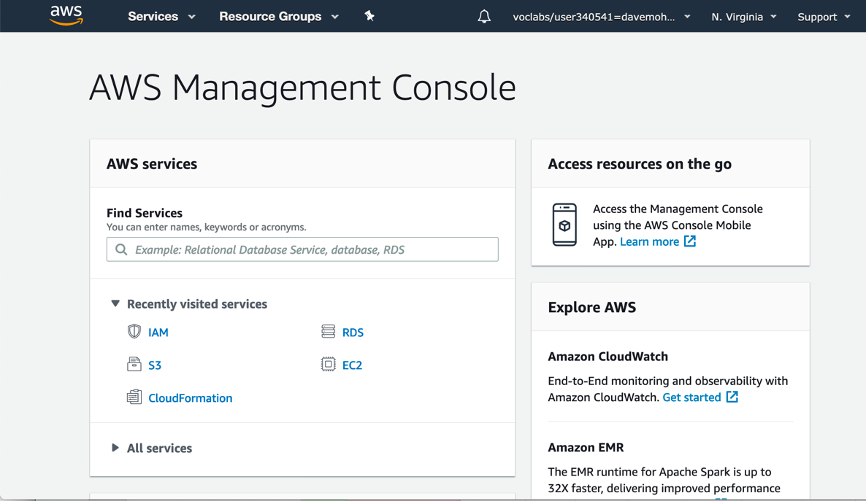



Identity federation with an identity broker
Customer
AWS Cloud
Application
User accesses broker
AWS services
1
4
User accesses AWS services or console
Single sign-on (SSO)
Broker retrieves temporary security credentials from STS, passes them to user application
2
User authenticated
3
IAM
AWS STS
Corporate identity store
Identity broker
Role
Policy
Notes:
You will now learn how to accomplish identity federation by using an identity broker.
The process includes these steps:
A user accesses an application. The user enters their user ID and password, and submits them
The identity broker receives the authentication request. It then communicates with the corporate identity store, which might be Microsoft Active Directory or a Lightweight Directory Access Protocol (LDAP) server.
If the authentication request is successful, the identity broker makes a request to AWS STS. The request is to retrieve temporary AWS security credentials for the user application.
The user application receives the temporary AWS security credentials and redirects the user to the AWS Management Console. The user did not need to sign directly in to AWS with a different set of credentials. This process is an example of a single-sign on (SSO) implementation. The user application could also use these same temporary AWS security credentials to access AWS services if the IAM policy document allows it.

Slide 40


Identity federation using SAML
Customer
Assertion posted to sign in endpoint for SAML
AWS Cloud
IAM
User navigates to a URL
4
Role
1
Sign-in endpoint for SAML
AWS STS
Policy
Redirected to the console
3
5
IdP returns SAML assertion
2
IdP authenticates user
Identity store (LDAP or Microsoft Active Directory)
Portal (IdP)
Notes:
You will now learn about the second option for accomplishing identity federation. This approach uses the SAML open standard for exchanging authentication and authorization data between IdPs and service providers.
The process involves these steps:
A user in your organization navigates to an internal portal in your network. The portal also functions as the IdP that handles the SAML trust between your organization and AWS.
The IdP authenticates the user’s identity against the identity store, which might be an LDAP server or Microsoft Active Directory.
The portal receives the authentication response as a SAML assertion from the IdP.
The client posts the SAML assertion to the AWS sign-in endpoint for SAML. The endpoint communicates with AWS STS, and it invokes the AssumeRoleWithSAML operation to request temporary security credentials and construct a sign-in URL.
The client receives the temporary AWS security credentials. The client is redirected to the AWS Management Console and is authenticated with the temporary AWS security credentials.

Slide 41


Amazon Cognito
Amazon Cognito is a fully managed service.
It provides authentication, authorization, and user management for web and mobile applications
Amazon Cognito provides web identity federation
They can be used as the identity broker that supports IdPs that are compatible with OpenID Connect (OIDC)
Federated identities
Users sign in with social identity providers (Amazon, Facebook, Google) or with SAML
User pools
You can maintain a directory with user profiles authentication tokens
Amazon Cognito
Notes:
The third and final identity federation option is using Amazon Cognito. Amazon Cognito is a fully managed service that provides authentication, authorization, and user management for web and mobile applications. Users can sign in directly with a user name and password or through a third party, such as Facebook, Amazon, or Google.
The two main components of Amazon Cognito are user pools and identity pools.
A user pool is a user directory in Amazon Cognito. With a user pool, users can sign in to a web or mobile application through Amazon Cognito. They can also federate through a third-party IdP. All members of the user pool have a directory profile that can be accessed through an SDK.
Identity pools enable the creation of unique identities and permissions assignment for users. With an identity pool, users can obtain temporary AWS credentials to access AWS services or resources. Identity pools can communicate with Amazon Cognito user pools’ social sign-in with Facebook, Google, and Login with Amazon; and OpenID Connect (OIDC) providers.

Slide 42

Amazon Cognito example
AWS Cloud
Authenticate and get tokens
Redirect or post back
1
2
Amazon Cognito user pool
Federating IdP
Exchange tokens for AWS credentials
IdP token
3
Web or mobile application
AWS credentials
Amazon Cognito identity pool
Access AWS services with credentials
4
AWS services
Notes:
In this scenario, the goal is to authenticate a user using Amazon Cognito, and then grant that user access to another AWS service.
In the first step, the app user signs in through an Amazon Cognito user pool and, after successfully authenticating, receives user pool tokens.
Next, the app exchanges the user pool tokens for AWS credentials through an Amazon Cognito identity pool.
Finally, the app user uses those AWS credentials to access other AWS services.

